Slide 1
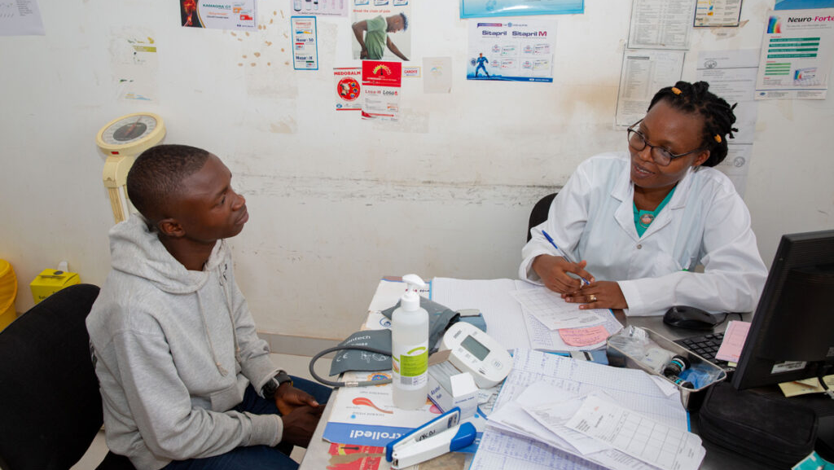
Healthcare Analytics
Data-Driven Assessment of Primary Healthcare
Access, Readiness, and Equity in Kaduna State Using Micro-Plan Data
Group 4 Project

Slide 2
Meet the Team
BA
Bilikisu Abdullahi
SA
Sidiq Abdulkadir Akanbi
SJ
Saadatu Jumare
AA
Abdulrashid Abdullahi
HD
Habila Dinatu Zephaniah
AB
Aliyu Bashir
6 Researchers
1 Unified Mission
Healthcare Equity

Slide 3
Introduction
Four Critical Areas of Assessment
1
Who Needs Care Most?
2
Who Has Access Problems?
Under-1 & Under-5 Children
Distance >5km
Most vulnerable pediatric populations
Geographic barriers to care
Pregnant Women
Hard-to-Reach (HTR)
Maternal health priorities
Terrain and infrastructure challenges
Persons with Disabilities
Security-Compromised Areas
Special accessibility requirements
Safety risks for patients and staff
3
Are Facilities Ready?
4
Where Should Resources Go First?
Staff Availability
High Population + Low Service
Healthcare workforce capacity
Demand-supply mismatches
Vaccine & Drug Availability
High Risk + Low Readiness
Essential medical supplies
Critical intervention zones
Reporting Tools (NHMIS)
Data collection infrastructure
Connecting The Dots: People → Access → Facility Readiness → Risk. And Together They Tell One Clear Story About Where Kaduna State Should Focus Health Interventions.

Slide 4
Question 1
Which LGAs Have the Highest Population but Poorest Access?
The Challenge
Priority Index Methodology Flow
Some LGAs have a large population , but these people often live far from facilities or rely on a limited number of facilities .
Population Data
Distance Data
Hundreds of thousands
Single-digit kilometers
How the Priority Index Was Calculated
To identify the areas with the greatest need, we didn't just look at who has the most people or who is the furthest from a clinic; we looked for the overlap of both.
1
Normalization Process
Scale both metrics to 0.0 - 1.0 range
2
1
Normalization
Scale population and distance to 0.0-1.0
3
2
Weighted Scoring
Combine into single Priority Index score
Priority Index Score
3
Threshold Analysis
Score approaching 2.0 = "Double-risk" area
Benchmark against 3km safety threshold
3km Safety Threshold
Separate "busy" from "isolated"

Slide 5
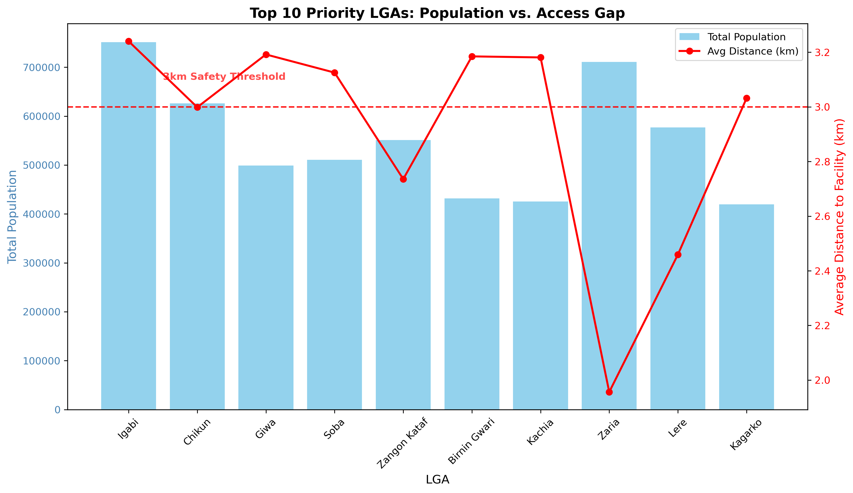
Priority Index Findings
The data indicate that Igabi LGA stands as the state's foremost health priority, marked by a "double burden" of the largest population (751,398) and the longest travel distance to facilities (3.24 km), leading to a significant priority index of 1.94.
Among the top 10 underserved regions, a systemic "distance penalty" is evident, with 60% of these LGAs, including Giwa, Birnin Gwari, and Kachia, surpassing a 3km safety threshold, implying that geographic isolation poses a major obstacle to care.
Conversely, Zaria faces a high-pressure situation where the primary issue is likely facility overcrowding rather than isolation, as it supports a large population despite a considerably lower distance metric of 1.95 km.
Strategically, these insights suggest that while LGAs such as Igabi and Chikun necessitate immediate infrastructure development to enhance accessibility, isolated regions like Giwa and Soba would gain the most from mobile clinics and improved emergency transport to address their 3.1km+ access deficiencies.

Slide 6
Question 2
Are Vaccines Aligned with the Under-5 Population Distribution?
The Core Question
Vaccine Alignment Analysis Framework
Vaccines are meant primarily for children under 5 years .
Step 1: Total Stock Consolidation
Do facilities serving more infants actually have more vaccines?
BCG
Penta
Measles
+ Others
Total Vaccine Stock per Facility
Measuring the Vaccine Alignment Gap
To determine if our vaccine distribution is meeting the needs of our children, we moved beyond simple inventory counts and performed a Supply-vs-Demand Ratio analysis:
Step 2: Calculate Alignment Ratio
Vaccines Per Child = Total Stock ÷ Under-5 Population
Per facility catchment area
1
Total Stock
Consolidate BCG, Penta, Measles, etc. into single metric per facility
2
The Alignment Ratio
Step 3: Apply 1.0 Safety Threshold
Calculate "Vaccines Per Child" ratio
3
The 1.0 Safety Threshold
< 1.0
≥ 1.0
Ratio below 1.0 = immediate stock-out risk
Immediate Risk
Adequate Supply
Stock-outs & service denial
Sufficient for population

Slide 7
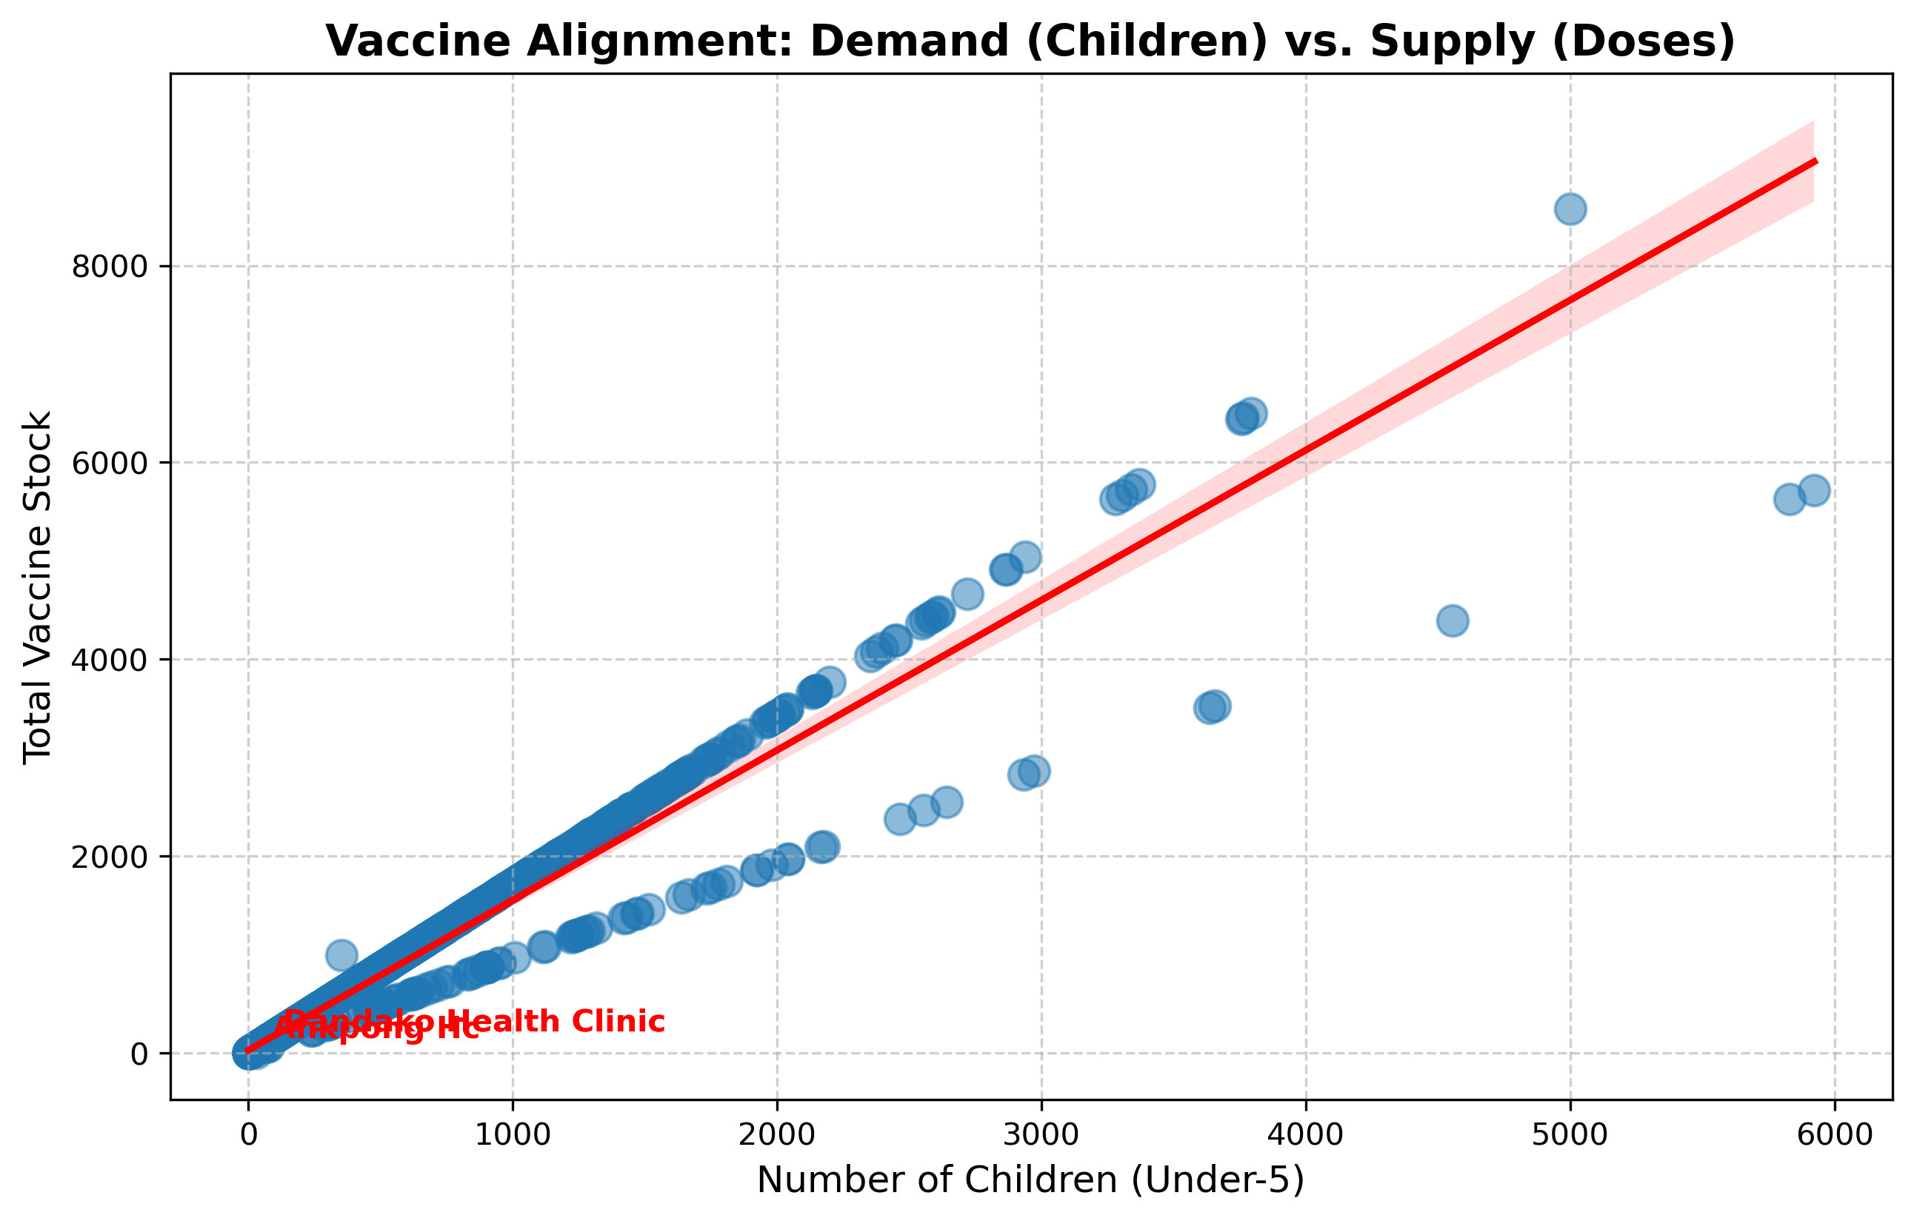
Vaccine Alignment Findings
Our assessment indicates a concerning geographic disparity in vaccine distribution. Although the overall supply in our state may appear sufficient, it is failing to reach the appropriate children. Ankpong Hc is currently classified as a complete 'vaccine desert' with no recorded inventory, while several high-traffic centers, such as Dandako and Television Phc, are functioning with fewer than one dose available per child.
Consequently, a child's likelihood of receiving immunization is presently dictated by their location rather than their actual need. We do not necessarily require additional vaccine purchases; instead, we must realign our logistics to transfer excess stock from over-supplied facilities to these 'red-flag' locations without delay.

Slide 8
Question 3
Where Are Pregnant Women and WRA Underserved?
Critical Services Needed
Maternal Health Gap Analysis Framework
ANC
Antenatal Care
Supply Side: Service Readiness
Skilled Delivery
Maternal Service Score
Maternal Drug Stock
FP Method Mix
FP
ANC_Register + ANC_Card
Fesolate + Folic_Acid
Mini pills + IUCD + Implants
Family Planning Services
Demand Side: Population Need
How We Arrived at the Gap Columns
Consolidating "Supply" (Service Readiness)
Pregnant Women Count
WRA Population
• Maternal Service Score: ANC register, ANC card availability
• Maternal Drug Stock: Fesolate tabs, Folic Acid quantities
Gap Score Interpretation
• FP Method Mix: Count of different contraceptive types
Calculating the "Gap" (Unmet Need)
High Score (e.g., 733.3)
Hundreds of women per unit of service
Gap Score = Demand ÷ Supply
Low Score
Well-resourced for population

Slide 9
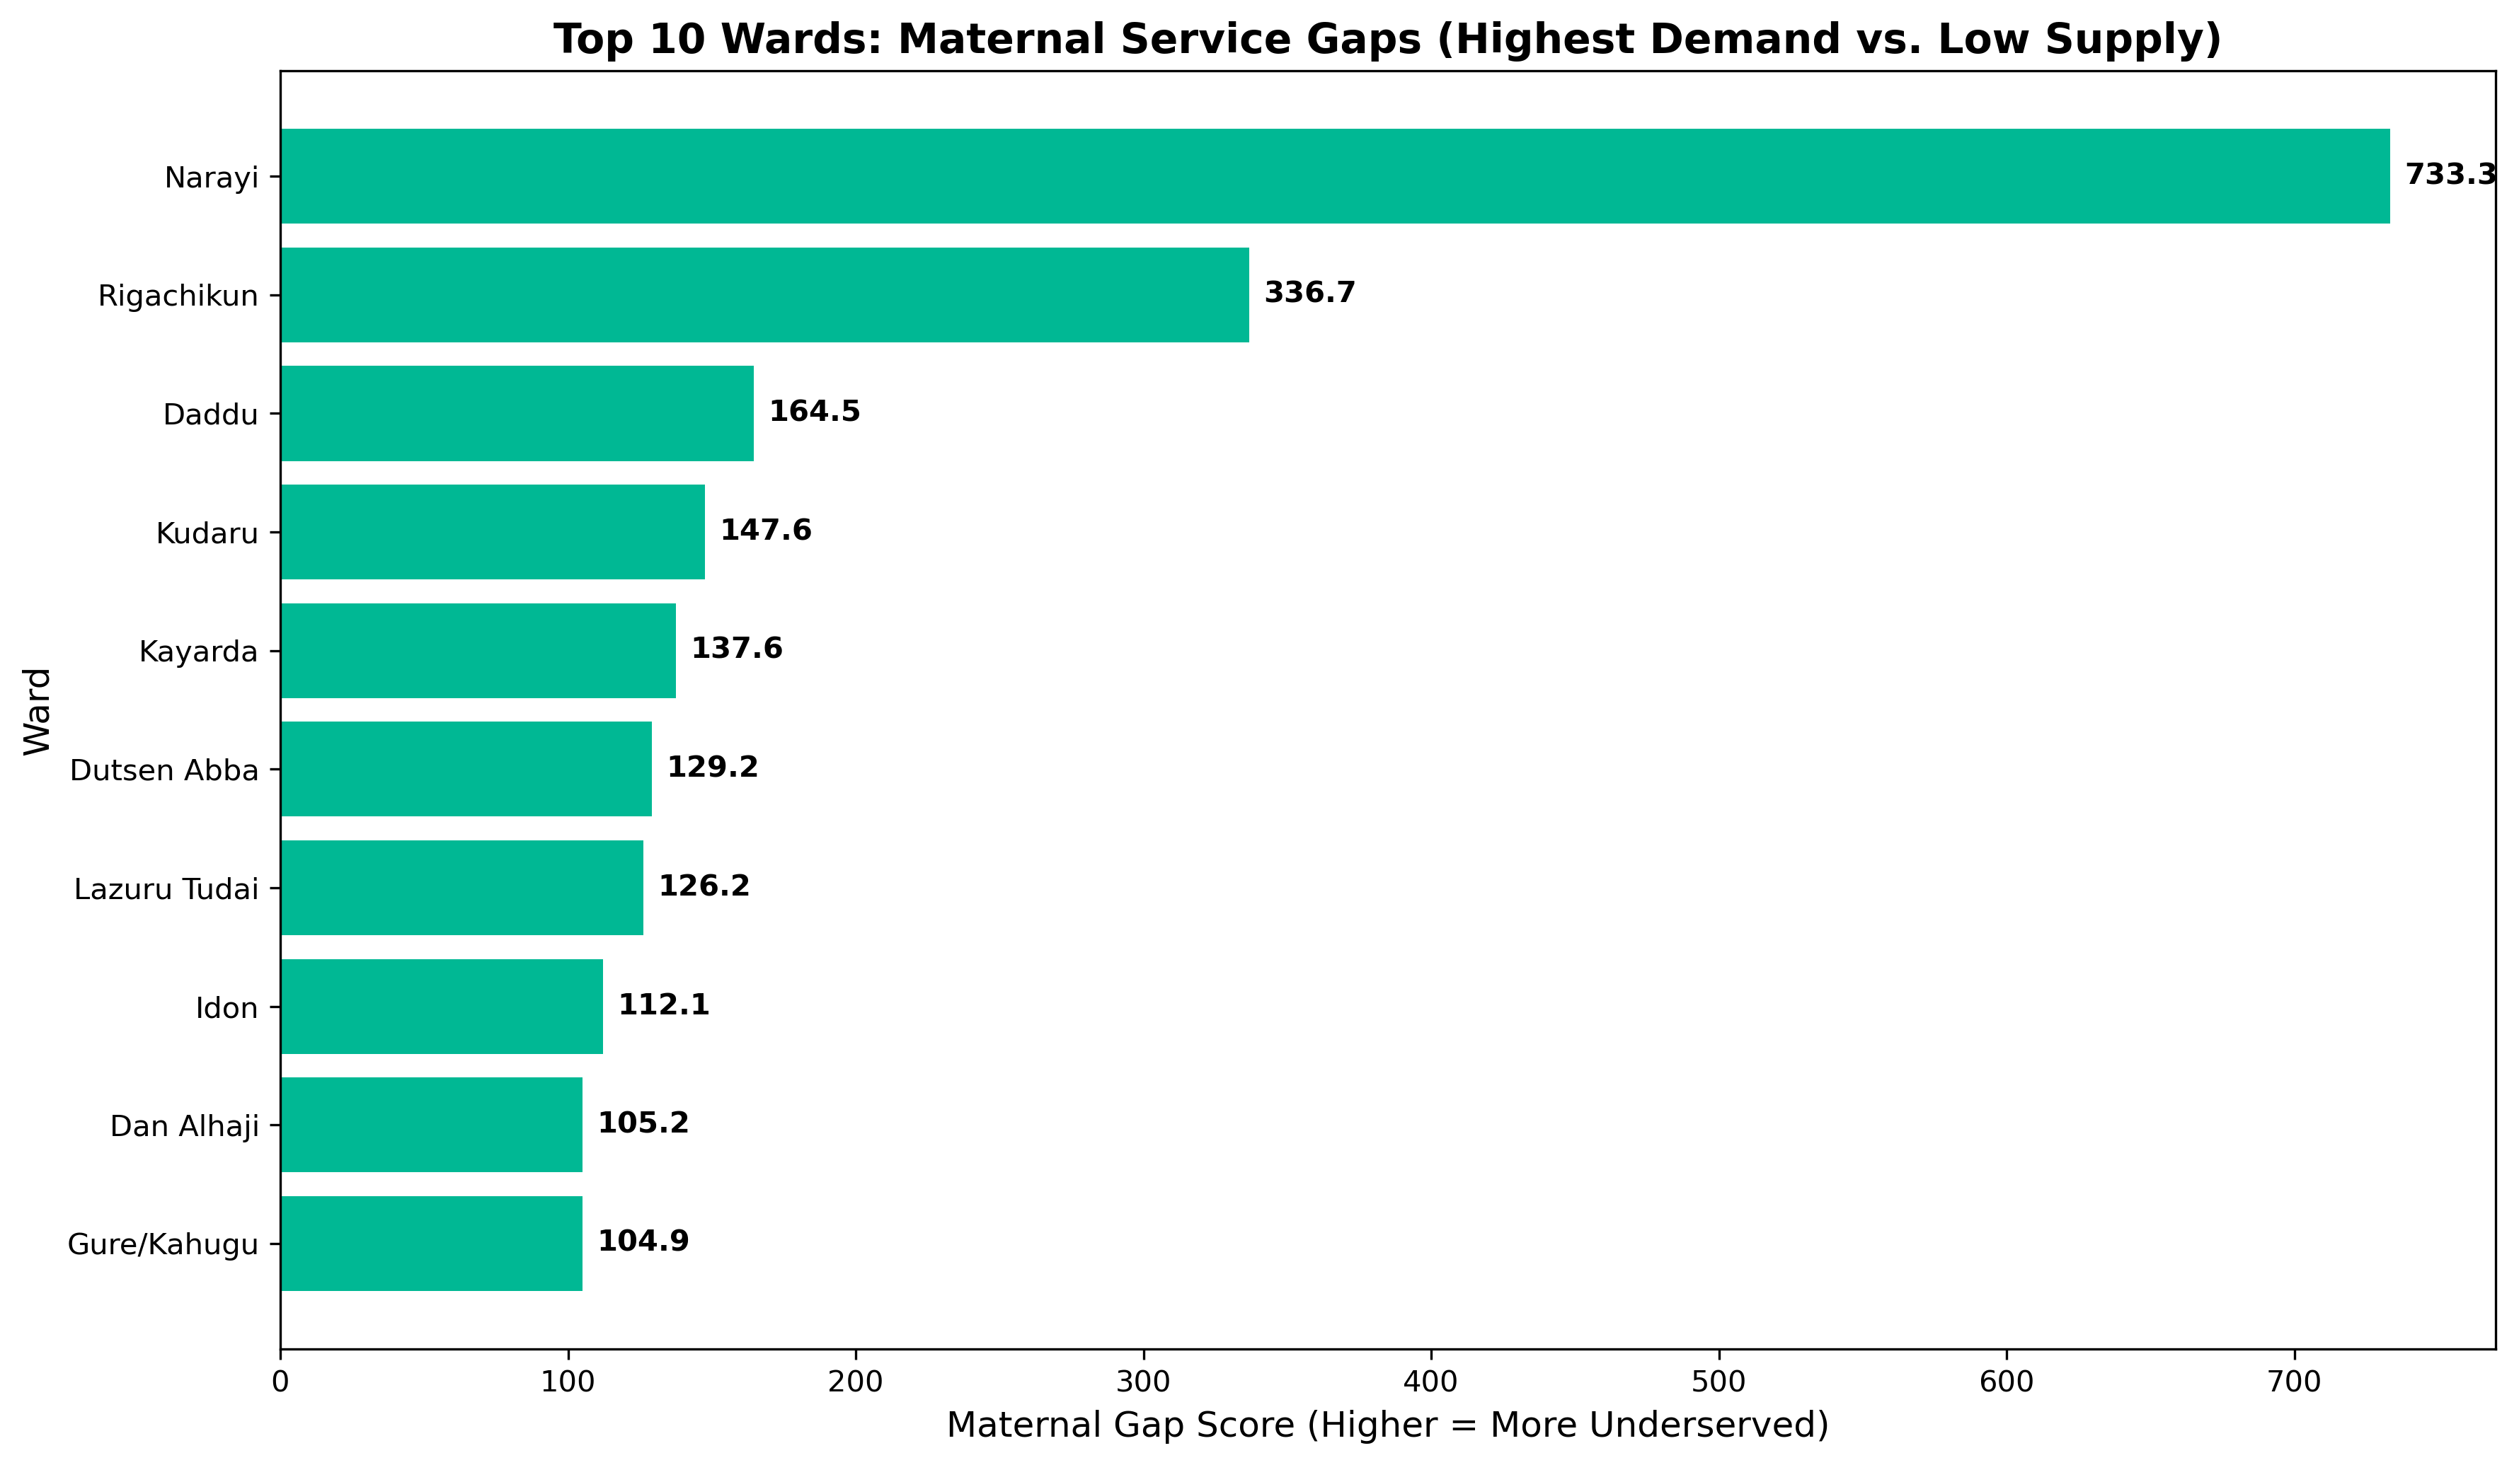
Maternal Health Service Gaps
Our analysis identifies Narayi Ward (Chikun) as the state's most critical maternal 'service desert,' where high demand is met with the lowest relative service readiness.
While Rigachikun (Igabi) manages the highest sheer volume of pregnant women, it is the systemic shortage of essential drugs in wards like Narayi, Daddu, and Kudaru that creates the highest risk for maternal outcomes.
To reduce mortality rates, resource allocation must shift from high-stock urban centers toward these 'Red Zone' wards, prioritizing immediate resupply of life-saving drugs and clinical tools where the gap between population and service exceeds the state average.

Slide 10
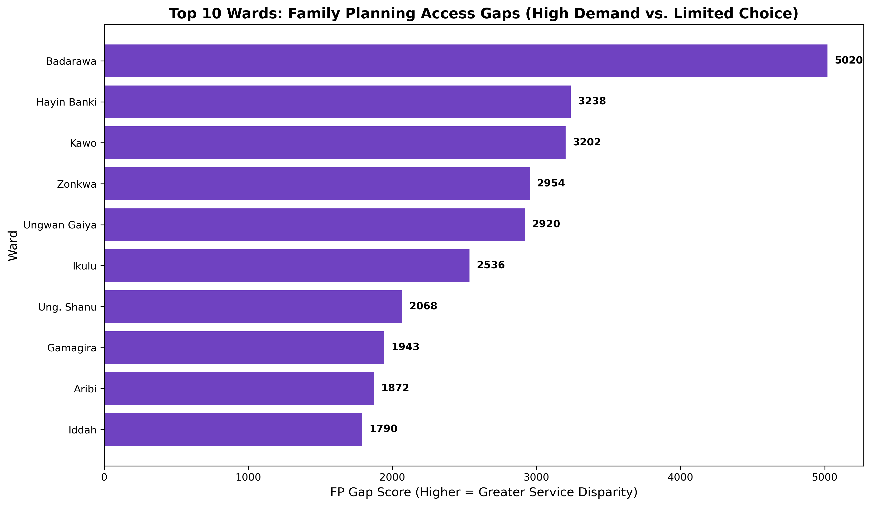
Reproductive Health Gaps
Reproductive health gaps are most severe in high-density urban hubs like Badarawa and Hayin Banki, where the 'Method Mix' fails to scale with the massive population of women of reproductive age.
We identified a significant 'Choice Desert' in Badarawa, where a population of over 40,000 women is being underserved relative to their needs.
Furthermore, consistently high gap scores in Zangon Kataf wards like Zonkwa and Ungwan Gaiya indicate that rural women are systematically restricted in contraceptive choice.
The strategic priority should be diversifying the methods available at these high-pressure facilities to ensure that population density does not dictate a woman's access to modern family planning options.

Slide 11
Question 4
How Do HTR and Security Risks Affect Service Readiness?
The Challenge
Risk Analysis Methodology
Hard-to-Reach and insecure areas often receive:
1
The Risk Flag
Fewer staff
Fewer commodities
Created a single "At Risk" category that flags any facility labeled as either:
Weaker reporting
HTR
Security
Hard-to-Reach
Compromised
The Core Question
2
Resource Aggregation
Are risky areas systematically disadvantaged ?
Total Staff Metric
Nurses + Midwives + CHEWs
Total Commodities Score
Drugs + Contraceptives combined
3
Comparative Profiling
Calculated the Average (Mean) staff and commodity levels for "Risk Areas" versus "Safe Areas" to prove if the disadvantage is a widespread trend rather than a one-off occurrence.

Slide 12
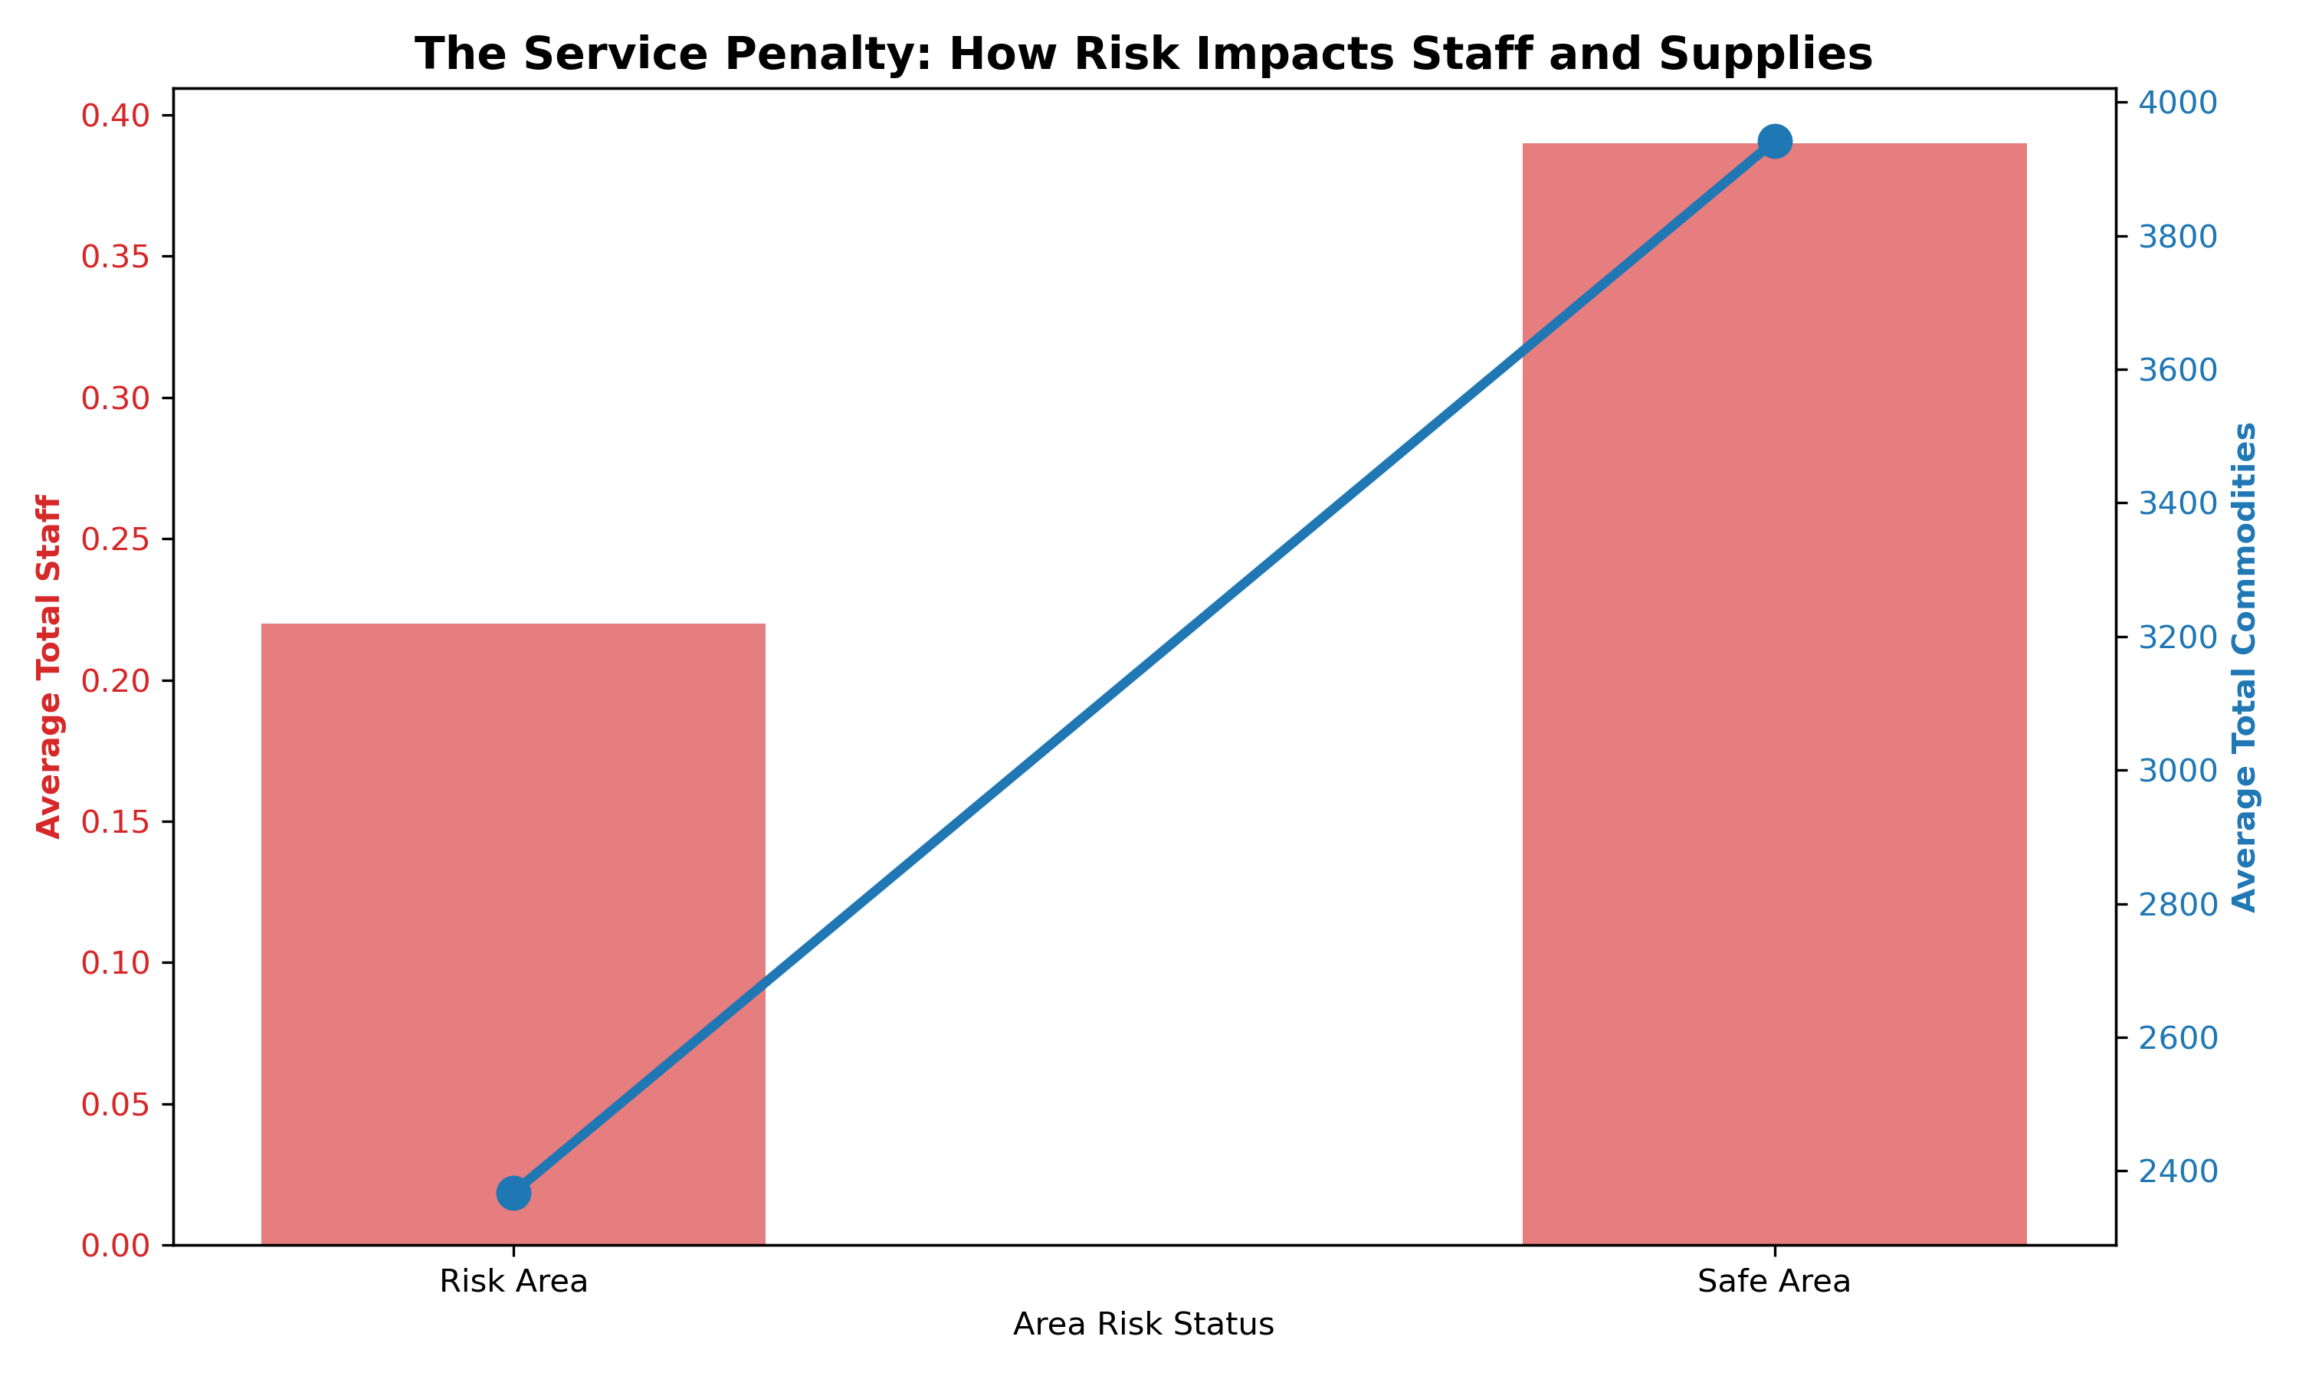
Risk Impact on Service Readiness
Our analysis proves that environmental risks create structural inequality in healthcare access. Facilities in HTR and insecure areas are systematically disadvantaged, operating with 44% less staff and 40% fewer essential commodities than safe areas.
Furthermore, the increased travel distance in these zones (3.63 km) compounds the risk for patients seeking care at under-resourced centers.
To achieve health equity, we recommend implementing specialized 'Hard-to-Reach' supply routes and risk-based staffing incentives to ensure that safety and geography do not dictate the quality of care provided to our citizens.

Slide 13
Question 5
Which 20% of Wards Contribute to 80% of Unmet Need?
The Pareto Principle (80/20 Rule)
Pareto Analysis Framework
States that a small number of causes often account for a large share of outcomes.
To prioritize interventions, we dev. Composite Score
1
Normalize and aggregate three key gap indicators
Purpose:
Maternal Gap Score
Family Planning (FP) Gap Score
Geographic Distance
Focus on where problems are most concentrated
Direct efforts to areas with the biggest impact
Avoid spreading resources too thin
2
Cumulative Analysis
Rank wards by composite score and calculate cumulative contribution
3
80/20 Threshold Identification
Identify the point where 80% of unmet need is concentrated

Slide 14
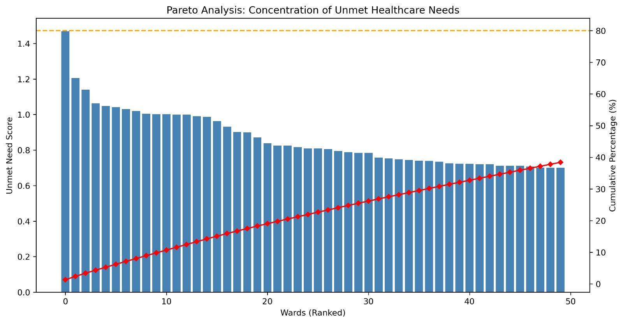
Pareto Analysis Findings
The Pareto analysis shows that unmet healthcare needs are broadly distributed across wards, with no small subset accounting for a disproportionate share of the total burden.
This indicates that targeted interventions in a few wards alone would be insufficient, and a more comprehensive, system-wide approach is required to effectively address unmet healthcare needs.
The absence of a clear 80/20 pattern suggests that healthcare challenges in Kaduna State require broad-based interventions rather than concentrated efforts in select areas.

Slide 15
Conclusion & Recommendations
Key Findings Summary
Strategic Recommendations
1
Infrastructure & Access
Access Gap: Igabi LGA faces a "double burden" with the largest population (751,398) and longest travel distance (3.24 km), requiring immediate infrastructure development.
Prioritize facility construction in Igabi/Chikun; deploy mobile clinics for Giwa/Soba (3.1km+ zones).
Vaccine Misalignment: Geographic disparity exists where vaccine supply fails to reach appropriate children - "vaccine deserts" like Ankpong Hc require urgent stock reallocation.
2
Supply Chain Optimization
Implement real-time vaccine redistribution from over-supplied to "red-flag" facilities within 48 hours.
3
Resource Reallocation
Maternal Health Gaps: Narayi Ward is a critical "service desert" with drug shortages creating highest maternal risk; Badarawa faces a "Choice Desert" for 40,000+ WRA.
Shift resources from urban centers to "Red Zone" wards (Narayi, Daddu, Kudaru); diversify FP methods in high-density hubs.
Risk-Based Disadvantage: HTR and insecure areas operate with 44% less staff and 40% fewer commodities, creating structural inequality.
4
Risk-Based Interventions
Establish specialized HTR supply routes and risk-based staffing incentives to close the 44% staff gap.
Immediate Action Required: A system-wide approach is essential as unmet needs are broadly distributed across Kaduna State.

Slide 16
THANK YOU
Group 4 Project
2026
Healthcare for All

